Slide 1
Introduction
Problem Statement Title: AI-Driven Crop Disease Prediction and Management System
Theme: Agriculture, FoodTech & Rural Development
PS Category: Software
Team Name – AgroVision

Slide 2
MOMENTUM TO AGRICULCUTRE
Team
AGRO VISION
Detailed explanation of the proposed solution
AI increases the accuracy level of detecting the deficiency in the plant.
Chat box help the farmer to share their problem and acquire the better solution.
Finance will store the seasonal records of farmer and help in better understanding of there expenditure and profit earn.
Innovation And Uniqueness Are:-
We Have create AI Detector Tool which have detect the problems of the plants such as (wheat, Rice, And Some other kind of Herbs etc.) It Also helps for predict the upcoming plant disease which also help to protect the crop fields.
We have created a platform for direct connection from farmer to consumer without interference of any broker. It improve the farmers life quality and security.

Slide 3







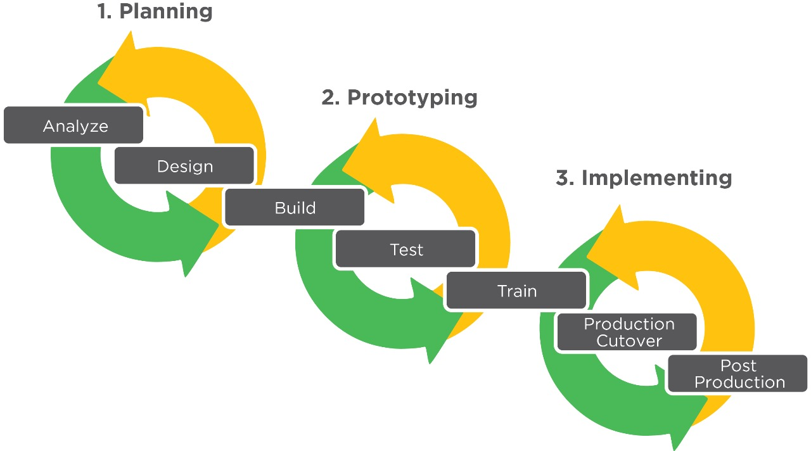
TECHNICAL APPROACH
Team
AGRO VISION
Technologies to be used are:- AI-Driven Decision Support Systems, Natural Language Processing (NLP), and the languages are:-
HTML CSS React JavaScript Python SQL PHP
Methodology and process for implementation:-
A website for farmers to solve the crop fields problem in real life with the help of Programming languages, Database, Frameworks and Inbuilt Artificial Intelligence.

Slide 4
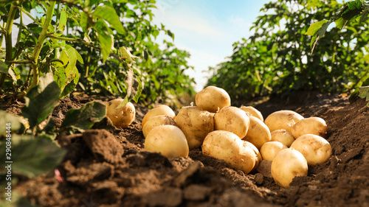
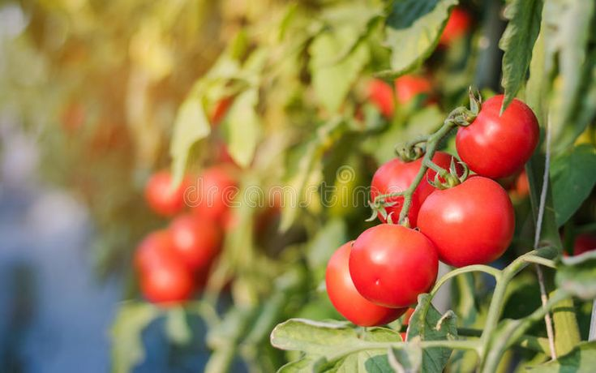



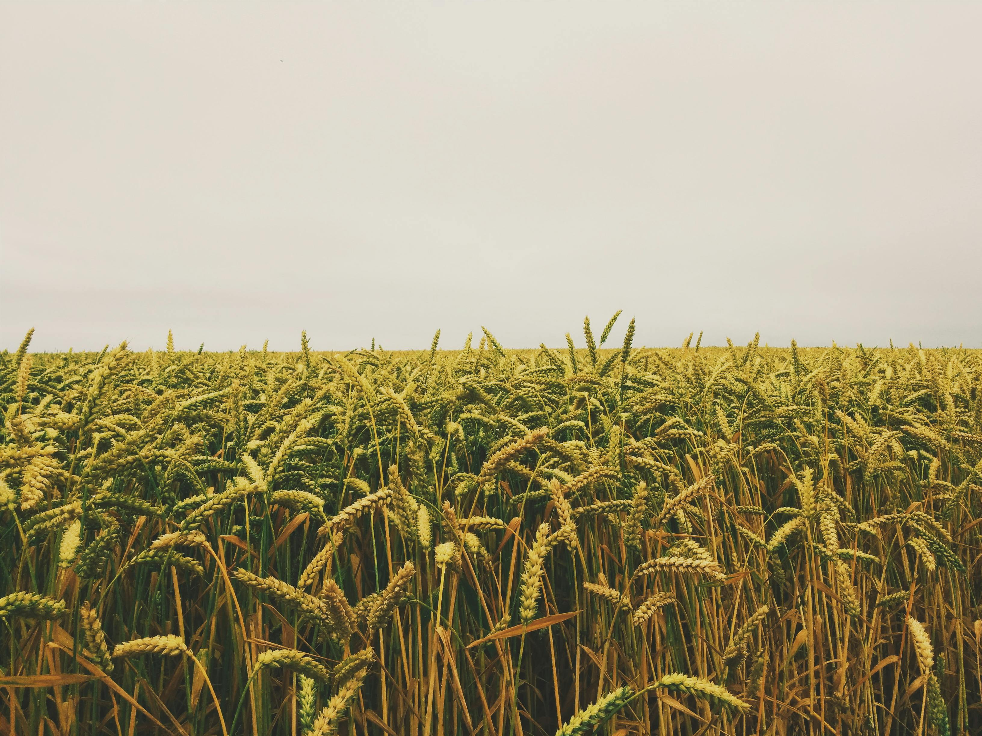
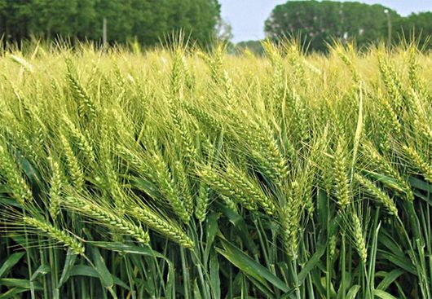
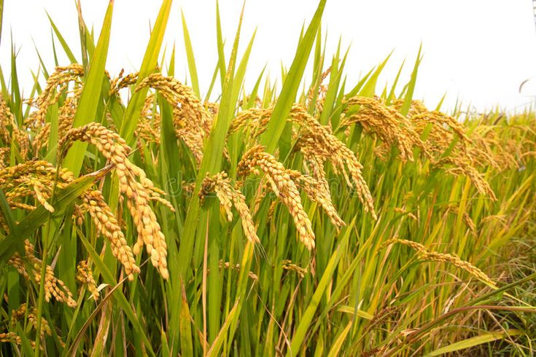
Potato
Image Pre-
processing
Image segmentation
+
Feature
Extraction
+
Classification
+
Diagnosis
Image Acquisition
Crop Field
Tomato
Leaf Images
Dataset
Wheat
Healthy
Diseased
Rice
Architecture of the leaf disease detection system

Slide 6
FEASIBILITY AND VIABILITY
Team
AGRO VISION
Analysis of the feasibility of the idea:-
Farmers: Small-scale to large-scale farmers in various regions.
Consumers: Individuals interested in sustainable food and local produce.
User-friendly Interface: Easy navigation and intuitive design.
Potential challenges and risks:-
Technical Issues: Ensure website stability and reliability.
Competition: Research existing platforms and differentiate your offerings.
Data Privacy: Implement strong security measures to protect user data.
Strategies for overcoming these challenges:-
The strategy is that farmers are not able to detect the damage crop in the initial stage, then they take advice from their consultant, there is no proper expertise whom they consult.
Farmers used to tell in their own way that there is nitrogen , iron deficiency in the plant, but they were not able to tell things accurately.
AI will give us accurate solutions and whenever we scan that particular plant then it tell us what is the exact problem, like if there is iron , zinc deficiency in the plant.
So this will ensure that farmers will not have to consult anyone and they will not have to suffer.

Slide 7
IMPACT AND BENEFITS
Team
AGRO VISION
Potential Impact On The Target Audience Is:-
Enhanced Decision-Making
Increased Efficiency
User Experience
Benefits Of The Social, Economic, Environmental Is:-
Social Benefits-
Educational Aspect
Technological Development
Economic Benefits-
Increased Productivity
Social Farming
Market Access
Environmental Benefits:-
Resource Efficiency
Waste Reduction
Lower Carbon Footprint
Improve Crop Health

Slide 8






RESEARCH AND REFERENCES
Team
AGRO VISION
We are researching on the crop disease and soil problems which impact on the plant. and On field data analysis and using some ai tools, website, & some images to train the inbuilt website AI. Which helps to built our website fast and responsive.
TOOLS & LINKS ARE:-
ChatGpt
GeeksForGeeks
IIL
Printrest
Wikipidea
NMSA

